Slide 1
duqtools introduction
Stef Smeets, Victor Azizi
2023-03-20

Slide 2
What is duqtools?
Duqtools is a tool for Dynamic Undertainty Quantification for Tokamak reactor simulations modelling
Open-source package written in Python (Apache 2.0)
Documentation: https://duqtools.readthedocs.io
Source code: https://github.com/duqtools/duqtools

Slide 3
Why duqtools?
Reduced order models need many runs
duqtools allows ensemble runs with hypercube sampling
Many outputs are difficult to inspect manually
duqtools can visualize and merge ensemble runs

Slide 4
What can duqtools do?
Set up 100s of simulation runs from a single template
Launch canonical UQ with minimal programming
Batch job submission and status tracking
Supports the Standardized Interface Data Structures (IDSs) data directory
Compare and visualize 100s of simulations in one overview
Display and merge simulation results as confidence ranges and distributions

Slide 5
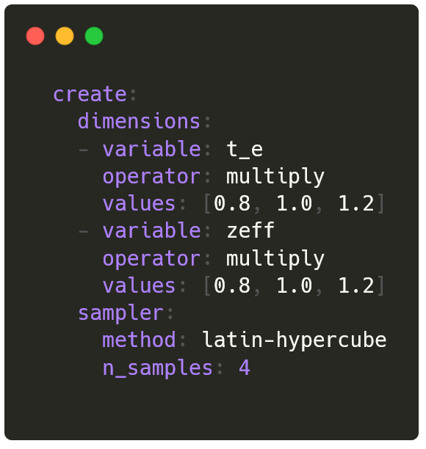
Automated run creation
Template-based run creation
Set up variable dimensions
Generate new IMAS data
Smart hypercube sampling
Support for coupled variables
t_e |  | zeff
0.8 |  | 0.8
1.0 |  | 1.0
1.2 |  | 1.2

Slide 6
Hypercube sampling
Sample random numbers in which samples are distributed evenly over a sample space
Dim X
Dim X
Dim X
Dim Y
Cartesian product
(all combinations)
Random sampling
(uneven distribution)
Latin hypercube
(evenly distributed)

Slide 7
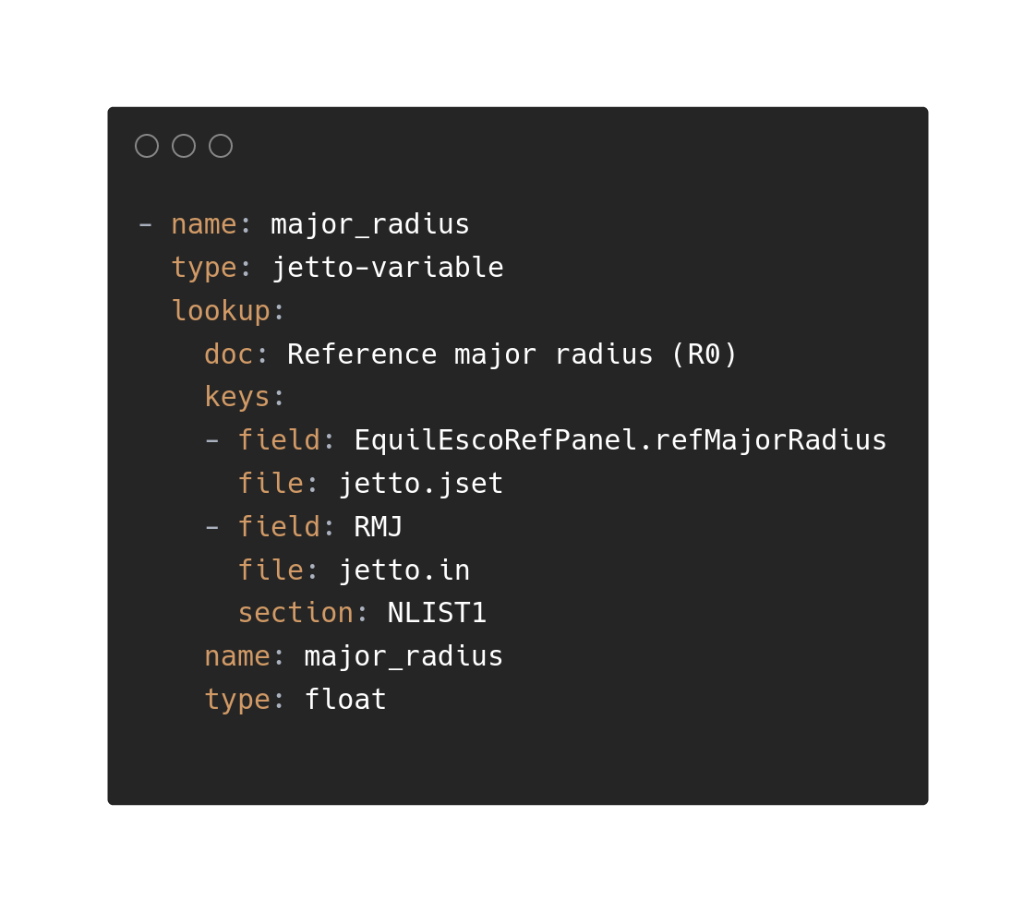
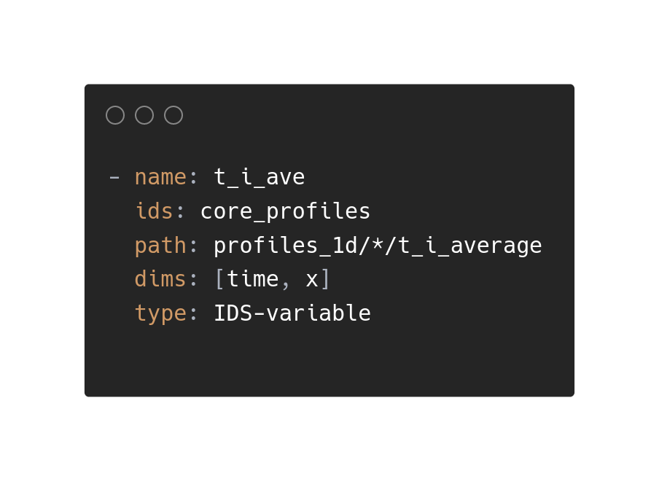
Transparent IDS or JETTO variables
To make points in an ensemble we need to edit variables
IDS variable
Jetto variable
All variables can be coupled for sampling

Slide 8
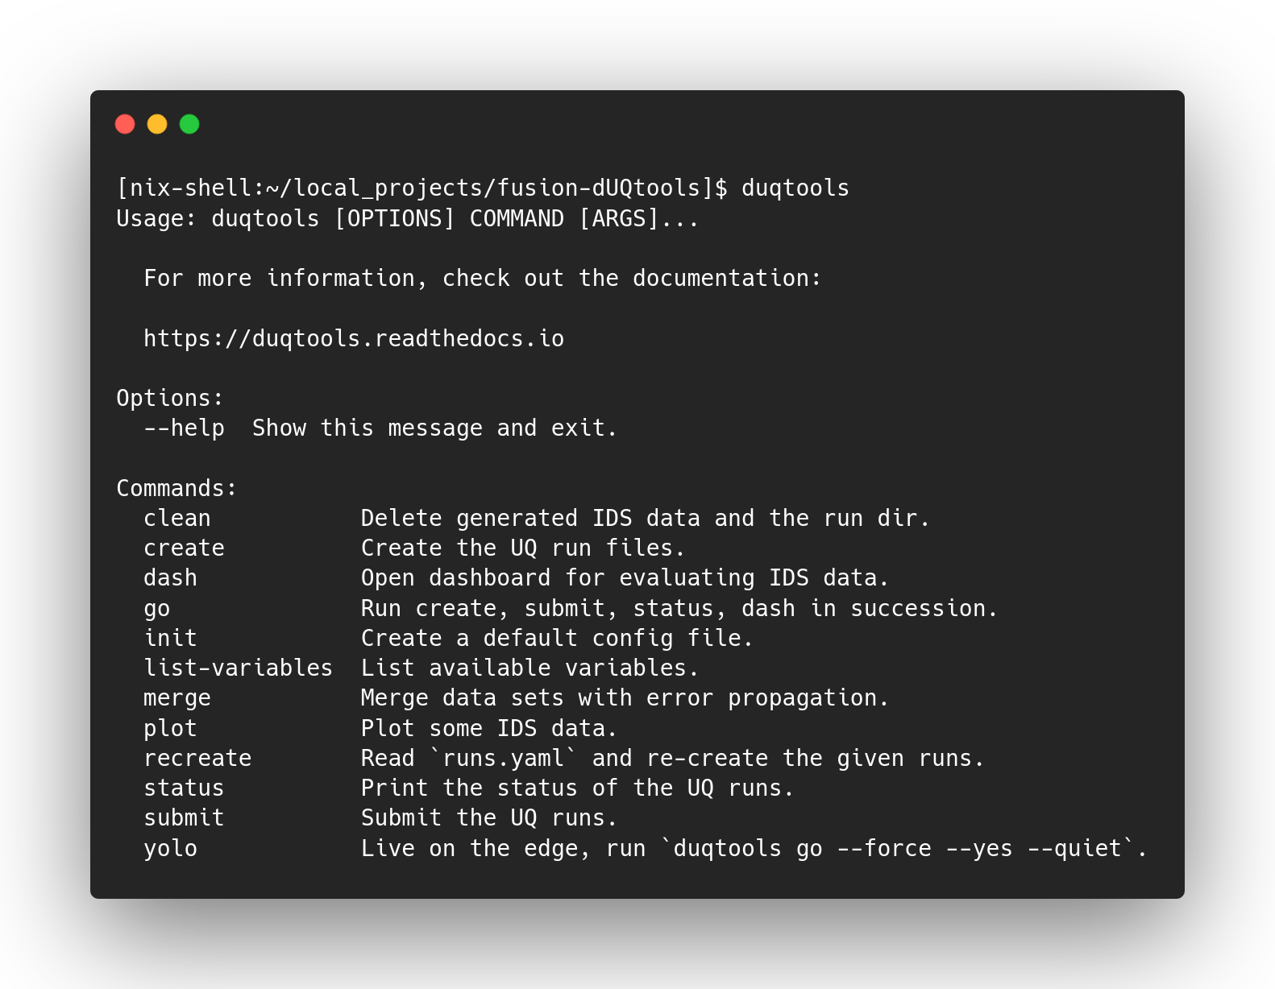
duqtools in practice
Available from pypi → pip install duqtools
Needs an IMAS environment to work with IMAS data (we would ❤️ pip install IMAS)

Slide 9
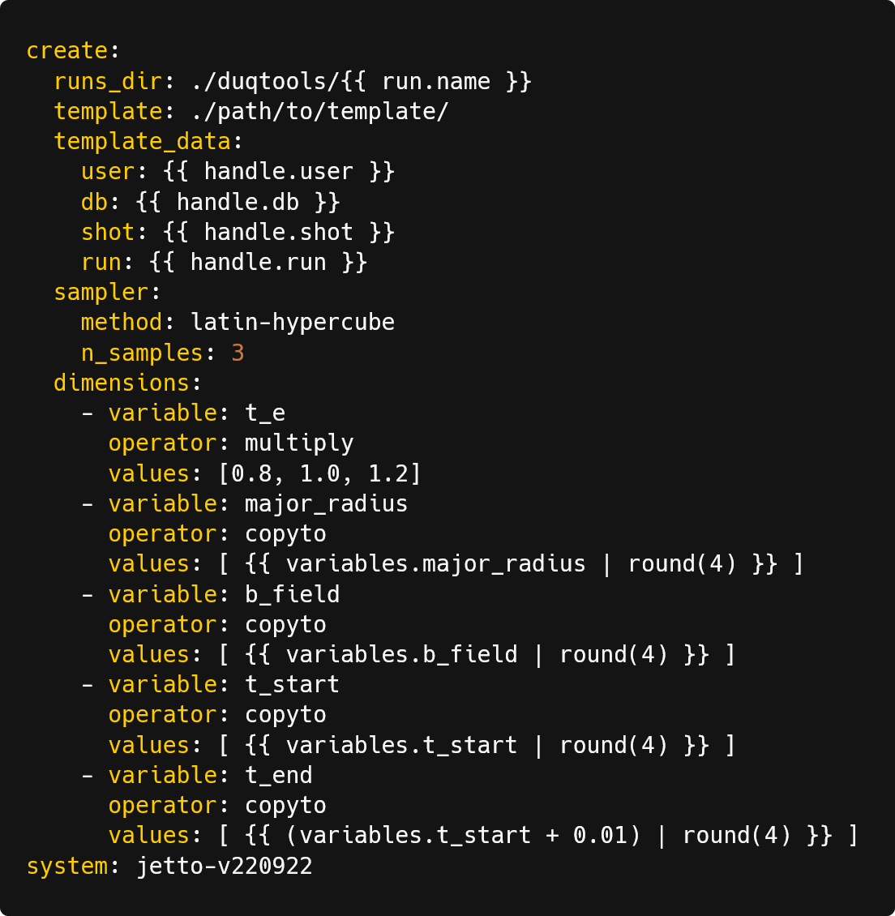
Canonical UQ
pre-defined UQ template
User can set up standardized sensitivity and UQ with minimal programming
duqtools setup –-handle g2aho/aug/36982/2
duqtools create

Slide 10
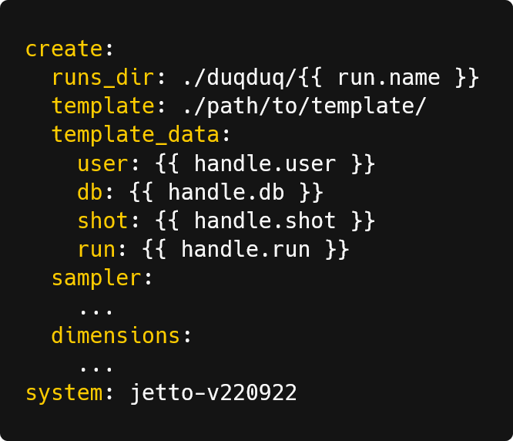
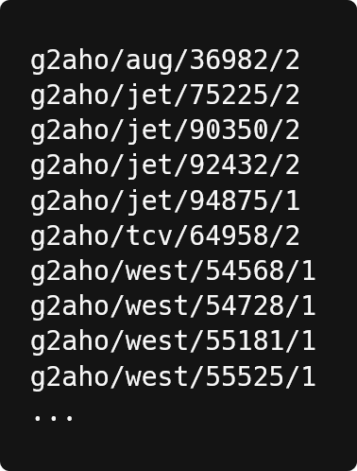
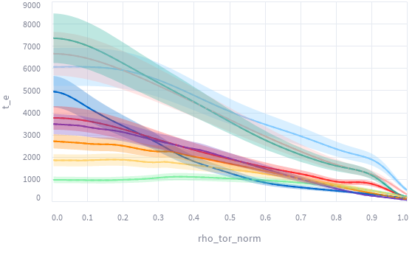
Large scale validation
Automated run creation and submission using standard templates
Canonical UQ
template
List of IMAS data
duqduq
Demo: https://duqtools.readthedocs.io/en/latest/examples/demo_lsv_run/

Slide 11
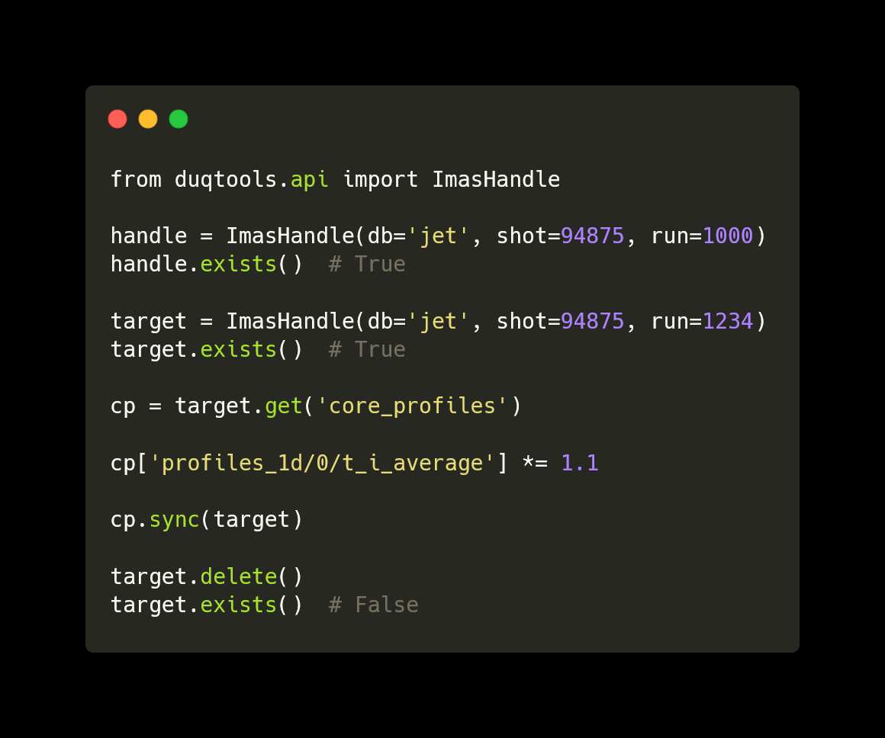
duqtools as a library
duqtools has a Python API so that it can be used as a library for exploring, manipulating, and plotting IMAS data
Example notebooks:
https://duqtools.readthedocs.io/en/latest/scripts
Example scripts:
https://duqtools.readthedocs.io/en/latest/examples
API reference:
https://duqtools.readthedocs.io/en/latest/api

Slide 12
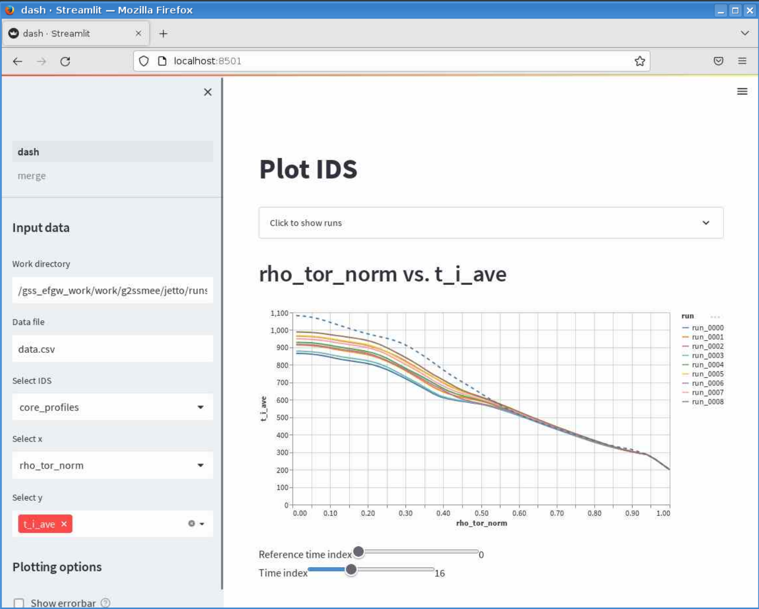
Dashboard
Explore and merge IMAS data
Duqtools dash

Slide 13
duqtools demos
Jetto UQ | https://duqtools.readthedocs.io/en/latest/examples/demo_single_run/
Large scale validation | https://duqtools.readthedocs.io/en/latest/examples/demo_lsv_run/
Docker | https://duqtools.readthedocs.io/en/latest/examples/duqtools_in_docker/
Prominence | https://duqtools.readthedocs.io/en/latest/examples/duqtools_on_prominence/

Slide 14


Fusion project
Development of the European fusion reactor simulation framework for experimental design, optimization, and control
“Empowering
researchers across
all disciplines
through innovative
research software”
Contact Person
Stef Smeets
Senior Research Software Engineer
s.smeets@esciencecenter.nl
Victor Azizi
Research Software Engineer
v.azizi@esciencecenter.nl

